Slide 1
Order statistics problem
B C Dhara
Department of Information Technology
Jadavpur University

Slide 2
Order statistics
Select ith smallest of n elements
  i=1: minimum
  i=n: maximum
  i=(n+1)/2: median
Simple approach: sort and index the ith element
  Worst case running time: O(n lg n)
    Using heap sort or merge sort (not quick sort)
B C Dhara, Dept. of IT, JU

Slide 3
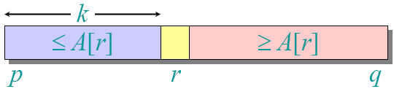
Selection in expected linear time
Randomize divide-and-conquer algorithm
Rand-select(A, p, q, i) // ith smallest element of A[p…q]
{ if (p==q) return A[p];
r=Rand-partition(A,p,q); k= r-p+1;
if ( i<k) return Rand-select(A,p,r-1,i);
else return Rand-select(A,r+1,q,i-k);
}
B C Dhara, Dept. of IT, JU

Slide 4
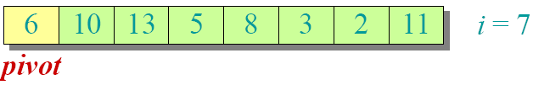
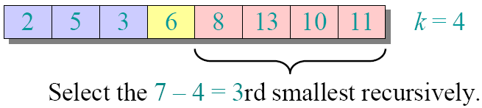
Select 7th smallest element
Partition:
B C Dhara, Dept. of IT, JU

Slide 5
Analysis
Best case:
T(n) = T(9n/10) + O(n)
  T(n) =O(n) by master theorem case 3
Worst case:
T(n) = T(n-1) + O(n)
  T(n) =O(n²)
B C Dhara, Dept. of IT, JU

Slide 6
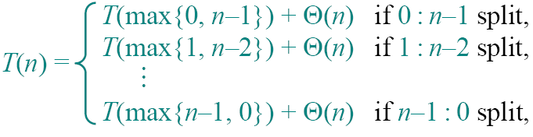
To obtain an upper bound, assume ith elements always falls in the larger side of the partition
B C Dhara, Dept. of IT, JU

Slide 7
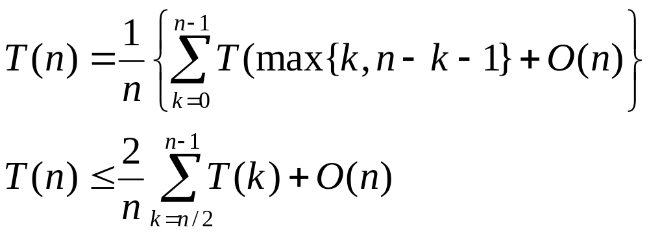
By substitution method we can prove that T(n) ≤ cn ➔ T(n) = O(n)
B C Dhara, Dept. of IT, JU

Slide 8
Worst-case linear time order statistics: method is Select
Select(A, i, p, q)
  Divide the n elements into groups of 5 (last group may contains less elements) O(n)
    Find median of each group
    Find median of n/5 medians. say, x
  Partition the input data set around x and position of x is k
  if (k ==i) return x
  else if i < k Select (A, i, p, k-1) //from lower part
    else Select (A, i-k, k+1, q) // from upper part
B C Dhara, Dept. of IT, JU

Slide 9
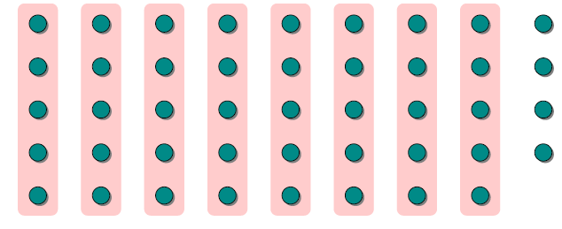
Divide the data set into groups of 5
B C Dhara, Dept. of IT, JU

Slide 10
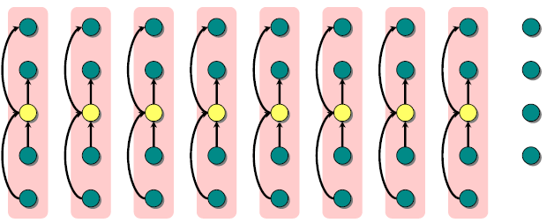
Find median of each group
B C Dhara, Dept. of IT, JU

Slide 11
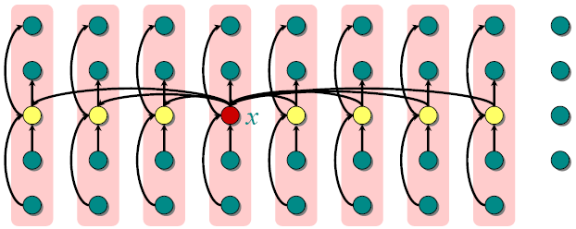
Find median of medians
B C Dhara, Dept. of IT, JU

Slide 12
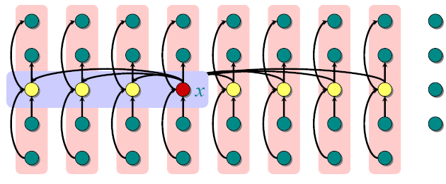
Analysis
At least half of n/5 medians are less than x
B C Dhara, Dept. of IT, JU

Slide 13
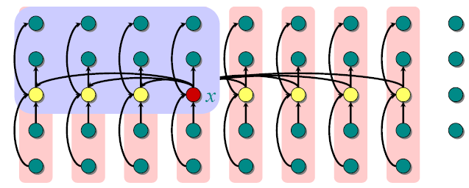
At least 3*((n/5)/2) elements are less than x
B C Dhara, Dept. of IT, JU

Slide 14
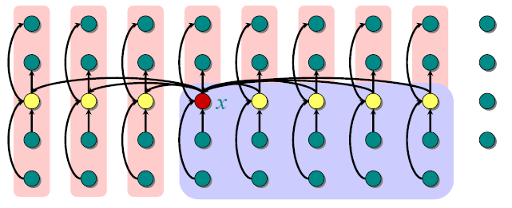
At least 3n/10 elements are greater than x
B C Dhara, Dept. of IT, JU

Slide 15
Select(A, i, p, q)
  Divide the n elements into groups of 5 (last group may contains less elements) O(n)
    Find median of each group
    Find median of n/5 medians. say, x
  Partition the input data set around x and position of x is k
  if (k ==i) return x
  else if i < k Select (A, i, p, k-1) //from lower part
    else Select (A, i-k, k+1, q) // from upper part
Always a fraction of elements are ignored
B C Dhara, Dept. of IT, JU

Slide 16
For n ≥ 50, 3n/10 ≥ n/4
So, for n ≥ 50 the recursive call to Select () is executed on ≤ 3n/4 elements
T(n) for n < 50 is O(1)
B C Dhara, Dept. of IT, JU

Slide 17
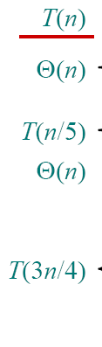

Select(A, i, p, q)
  Divide the n elements into groups of 5 (last group may contains less elements)
    Find median of each group
    Find median of n/5 medians. say, x
  Partition the input data set around x and position of x is k
  if (k ==i) return x
  else if i < k Select (A, i, p, k-1) //from lower part
    else Select (A, i-k, k+1, q) // from upper part
B C Dhara, Dept. of IT, JU

Slide 18

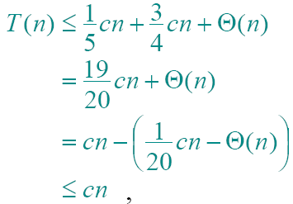
By substitution method
B C Dhara, Dept. of IT, JU

